Slide 1



Slide 2


index.tsx
index.html
App.tsx
===
<App />
<div id=“root” />
===
rootElement
render( , )

Slide 3
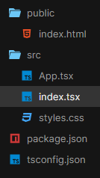
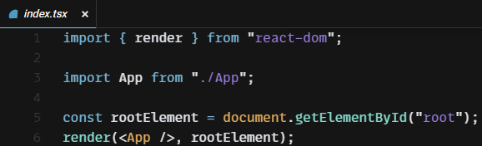
index.tsx
참고
.js JavaScript파일
.ts TypeScript파일
.tsx React
TypeScript파일
이 세가지는 import 할 때
확장자를 쓰지 않는다
index.html
App.tsx
===
<App />
<div id=“root” />
===
rootElement
render( , )

Slide 4
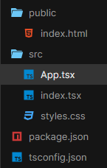
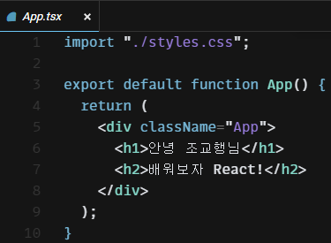
index.tsx
index.html
App.tsx
===
<App />
<div id=“root” />
===
rootElement
render( , )

Slide 5
index.tsx
index.html
App.tsx
===
<App />
<div id=“root” />
===
rootElement
render( , )

Slide 6
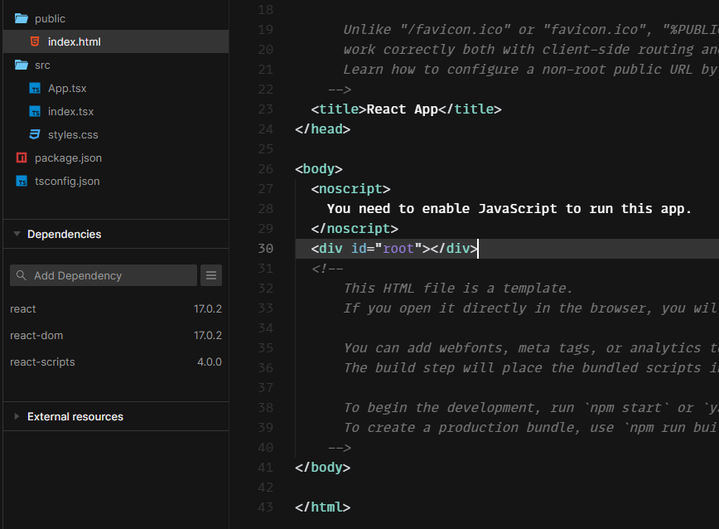
index.tsx
index.html
App.tsx
===
<App />
<div id=“root” />
===
rootElement
render( , )

Slide 7
index.tsx
index.html
App.tsx
===
<App />
<div id=“root” />
===
rootElement
render( , )

Slide 8
index.tsx
index.html
App.tsx
===
<App />
<div id=“root” />
===
rootElement
render( , )

Slide 9
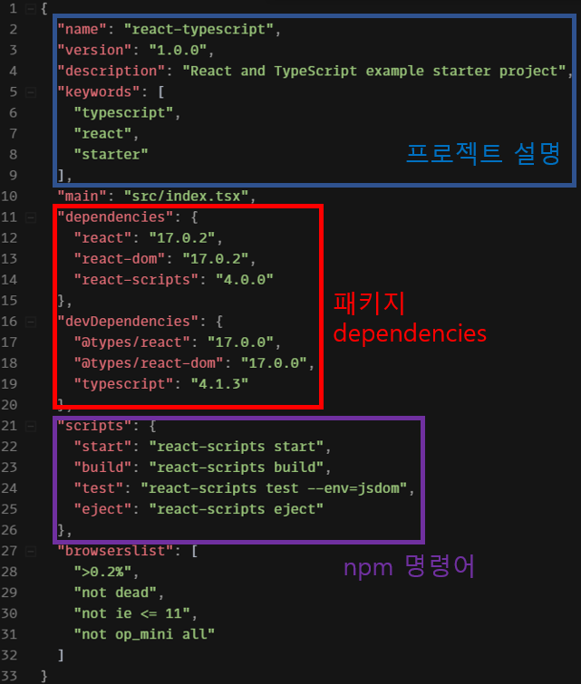

Slide 10






dependency (의존성)

Slide 11
